Slide 1

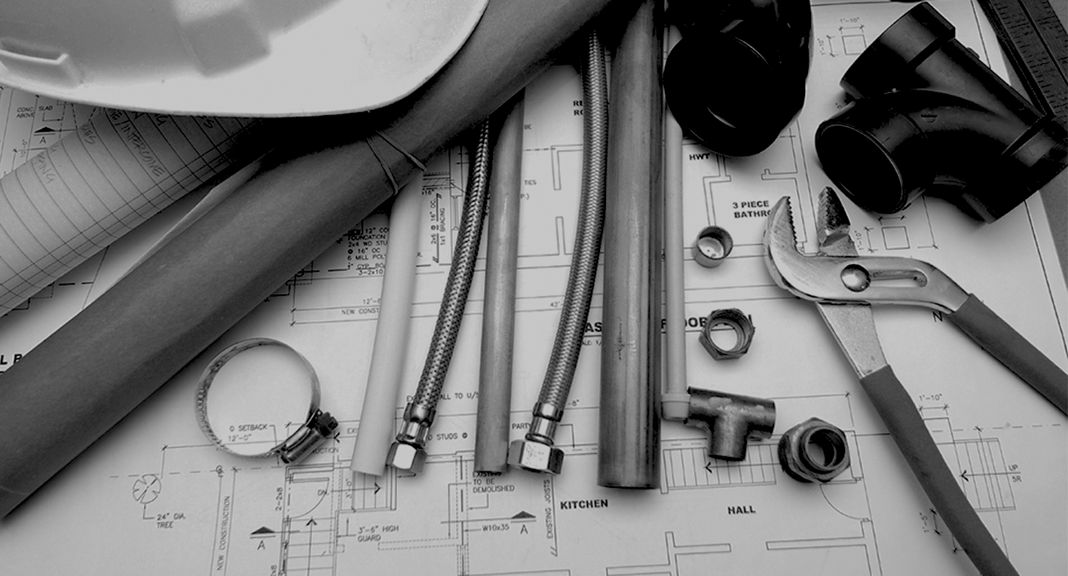
ABRINSTAL – BRASILIAN ASSOCIATION FOR THE CONFORMITY AND EFFICIENCY OF INSTALLATIONS
Institutional Presentation

Slide 2

About ABRINSTAL
Timeline
Main projects
Strategy with institutions
International highlights
Associates
Supporters
Why to associate?
SUMMARY

Slide 3

Non-profit organization, created in 2006
Coordenates, represent and defends the installations sector interests in Brazil, in addition to representing the country in events and international fóruns of sector
Plans, organizes, promote and execute actions aimed at the conformity, performance, efficiency and sustainability of infrastructure installation:
About
ABRINSTAL
Electric
Hidraulic
Sanitary
Fuel gases
Prevention and combat to fires
Building automation
Eletronic security
Solar heating
Telecommunications

Slide 4
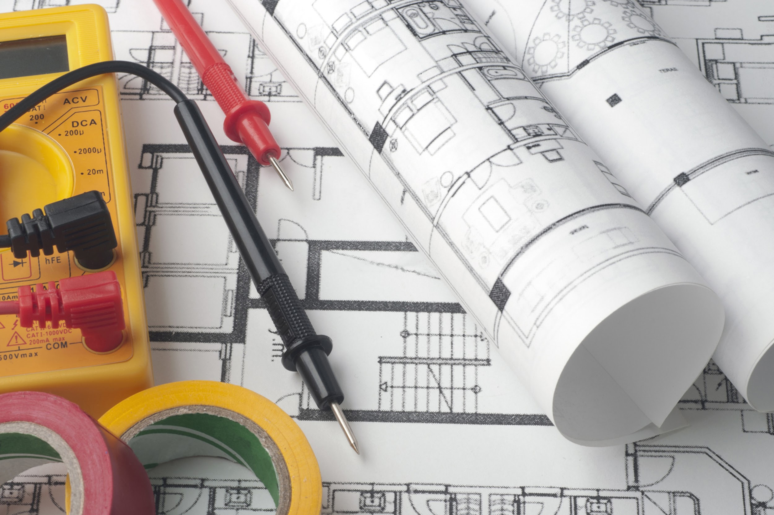
VISION
  Transform the infrastructure construction environment by promoting conformity, Sustainability, performance and eficiency of infrastructure installation
  MISSION
  Promote the development and improvement of infrastructure installation in Brazil through actions to encourage technological development and innovation, support the energy transition, support technical standards, train and improve human resources and other infrastructure improvement activities in the country
About
ABRINSTAL

Slide 5
VALUES
  Develop projects with quality, safety, conformity and transparency, ensuring effective results for the various stakeholders
  GOALS
  Increase the safety and resilience of the end consumer and Society, promoting ethics in relationships and compliance with technical regulations and the development of sustainable solutions
Sobre a
ABRINSTAL

Slide 6
Coordenates the Brazillian Comitee of Management and Saving of Energy- ABNT/CB-116
Represents Brazil in TC301 (Management and saving of energy ISO 50.001)
Coordenates BIP: Installers and Facilities Companies Conformity Evaluation System
Promotes and spread the best practicies of the installations sector to the governement, press, NGOs and the civil society
Arranges strategic events to the installations sector and promotes networking between professionals of the sector
Performs projects: technical studies, planing, strategic evaluations and spread of information, linked to conformity, Sustainability, performance and efficiency of installations
About
ABRINSTAL
OUR MAIN ACTIVITIES

Slide 7
ABRINSTAL timeline
2006 – ABRINSTAL is created – From Qualinstal’s activities with Sindinstalação
2008 – Execution of the first projects of Research, Development and Innovation (RD&I)
2011 –Begins to participate in international standardization activities, such as ISO meetings relating to issues of energy economics and management and climate change
2013 – Becomes member of World Plumbing Council - WPC
2015 – Assists in the creation and takes over the management of CB-116 Energy Management, from ABNT
2018 – Agreement with Procel / Eletrobras to promote energy management
- BIP release – Building Installation Performance
- Technical and Institutional Cooperation Agreement with SindusCon-SP
2021 – Establishes support structure for USP-RCGI advocacy projects

Slide 8

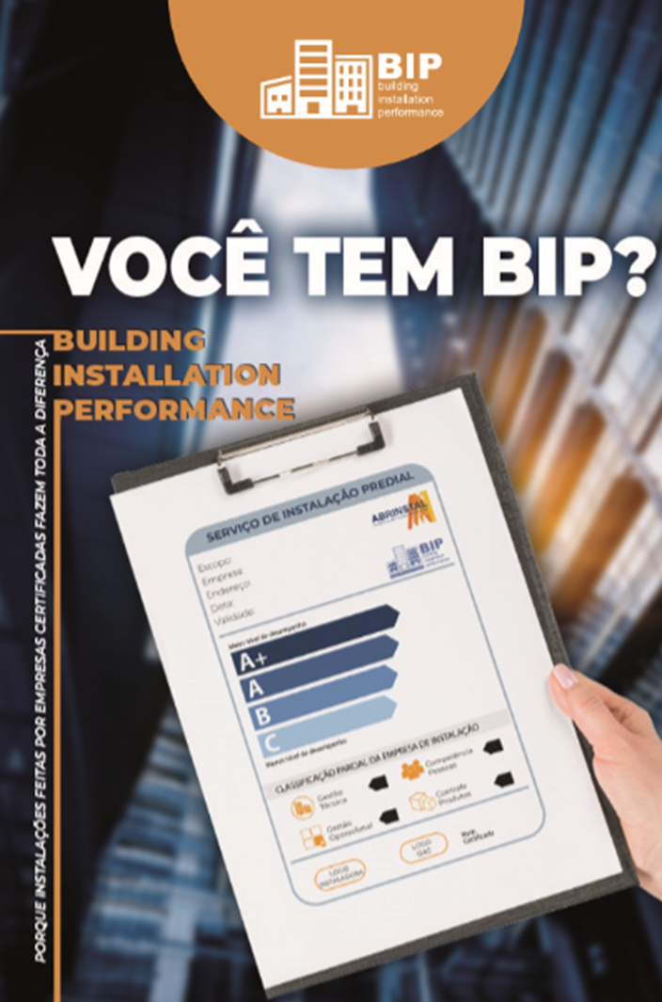
MAIN PROJECTS
AND STRATEGIC ACTIONS
> Development of actions within the civil construction market to qualify installation companies and monitor the conformity, Sustainability, performance and efficiency of installations. The program includes:
Definitions of requirements for certification of installation companies
Monitoring of certified installation companies
Annual fórum to publicize issues related to certification
Support for the “voluntary” certification process

Slide 9







2026 BIP SPONSORS

Slide 10
Capacity and training
Training to disseminate knowledge and encourage discussion of topics related to the conformity, Sustainability, performance ande efficiency of the infrastructure installation:
Workshops to discuss new developments in each of the main installation areas: fuel gases, Electric and hydrosanitary
Adequacy of workforce training and employability in the sector
Brand promotions at training and training events
Approaching other organizations in the sector
MAIN PROJECTS
AND STRATEGIC ACTIONS

Slide 11
Good Practices Manual
Detail of operational procedures and guidelines for carrying out infrastructure services in the installation segments of the fuel gases, electric, hydrosanitary, solar
Establishment of technical issues to meet sectoral priorities, based on debates with stakeholders and consensus on best practices with interested parties
Advancement in the model for improving requirements in civil construction, complementing details of technical standardization
MAIN PROJECTS
AND STRATEGIC ACTIONS

Slide 12
Monitoring Pathologies in Infrastructure Installations
  Observatory with construction companies and other agents in the civil construction sector to identify pathologies in building installation services
  Observation base for defining priorities and conformity actions in the building installation sector
MAIN PROJECTS
AND STRATEGIC ACTIONS

Slide 13
Installations Conformity Map
  Survey of items considered critical in the installtions (products, labor, services)
  Survey and analysis of the regulatory situation (standardization, technical specifications, regulations, conformity assessment)
  Critical analysis and definition of the conformity map of Building installations (products, labor, services)
  Monitors the evolution of regulatory and conformity issues associated with the installations sector (standards, laws, technical regulations, ordinances, etc)
MAIN PROJECTS
AND STRATEGIC ACTIONS

Slide 14

Management and Saving of Energy
  Management of ABNT CB-116 – with national coverage within the scope of ABNT, and international, through the representation of the country in relevant ISO forums
  Coordination and participation in international standardization forums, identifying new prioritary standarts, promoting the exchange of experiences and initiatives in this sector.
  Monitoring of the CCCC (TMB – Climate Change Coordination Committee)
MAIN PROJECTS
AND STRATEGIC ACTIONS

Slide 15

Management and Saving of Energy
2026 SPONSORS
MAIN PROJECTS
AND STRATEGIC ACTIONS

Slide 16
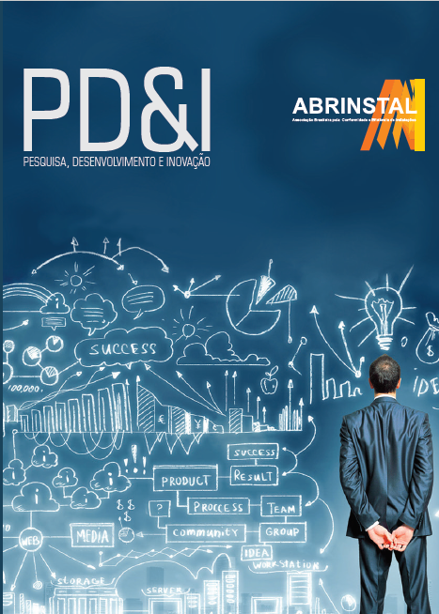
MAIN PROJECTS
AND STRATEGIC ACTIONS
Technologic Innovation and RD&I
Develops and maintains support programs to new products and technologies applicable to infrastructure installations, promoting technical analysis, consulting in the regulatory basis and the utilization of it.
Promotes aproximation between public servisse companies, installers, designers, architects, constructor, academia and research centres, aiming to the development of a robust market, that enables the advancement of the quality of infrastructure in the country.

Slide 17

Sector Awards - MASTERINSTAL
Biggest award event in the installations sector
Encourages research and innovation
cases that integrate the main representatives of the market: manufacturers, contructors, service concessionaires and installers.
MAIN PROJECTS
AND STRATEGIC ACTIONS

Slide 18
Water Management and Sustainability
Participation on the board of the World Plumbing Council – WPC
International coverage in promoting good practices in hydraulic installations, including water distribution and sanitary treatment
Actions aligned with the World Health Organization (WHO)
Analysis and implementation of international actions in Brazil
MAIN PROJECTS
AND STRATEGIC ACTIONS

Slide 19
Standardization
and
sectorial markers
Establishes and manages strategic plans of standardization in the installation sector. Also sets and publishes price and quality indicators of installation that are benchmarks to the decision making of the market.
Regulatory tracking
Monitors and participates of the evolution of regulatory topics associated with the installation sector (standarts, laws, technical regulation, ordinances, etc) in the national, statewide and municipal scopes as a way to guarantee the dissemination of information, easing the understanding of the law.
MAIN PROJECTS
AND STRATEGIC ACTIONS

Slide 20
> Institutional relationships and participation with GOVERNMENT groups
MME (Ministry of Mines and Energy) – GT Edifications
CGIEE (Energy Efficiency Index Management Committee)
ENBPar – Procel Management – CT Edifications
INMETRO – Technical Committee to certificate of products, systems, people and PBE
ABNT – Study Comissions associated to installations
STRATEGY
with institutions

Slide 21
Institutional Relations with INTERNATIONAL institutions
IAPMO – International Association for Plumbers and
Mechanical Officials
WPC – World Plumbing Council
NFPA – National Fire Protection Association
ISO – International Standardization Organization
UNIDO – United Nations Industrial Development Organization
ASHRAE – American Society of Heating, Refrigerating and Air-Conditioning Engeineers
INTERNATIONAL
HIGHLIGHTS

Slide 22
> We count on the participation of associates and supporters, which are strategic for the installation segment:
ABRASIP
IEE/USP
Secovi
Sindinstalação
SindusCon-SP
Installations representative
Designers representative
OUR
PARTNERS

Slide 23







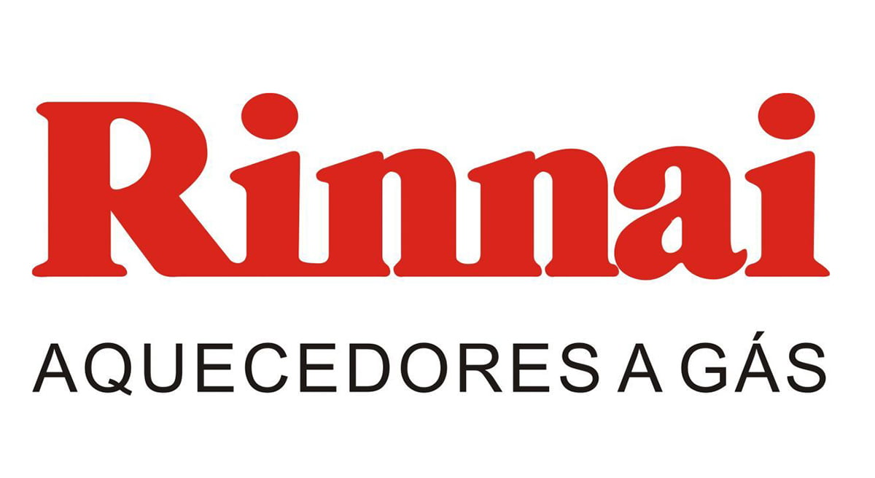
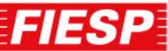




















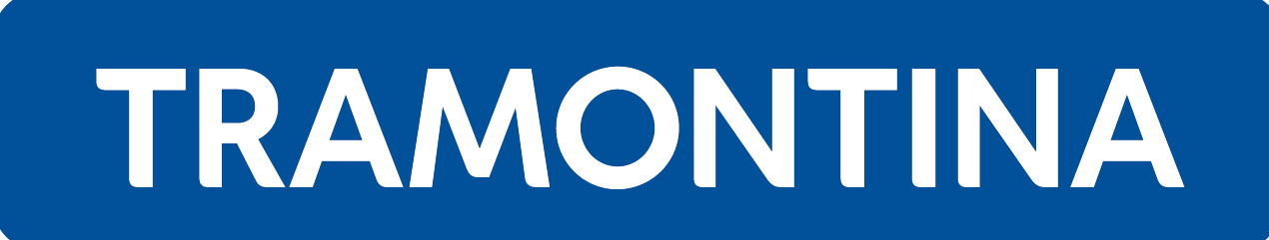








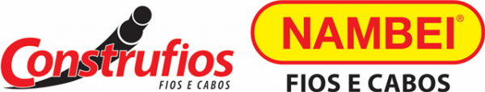

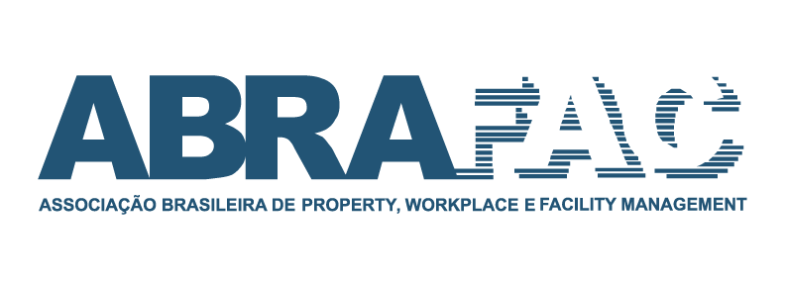










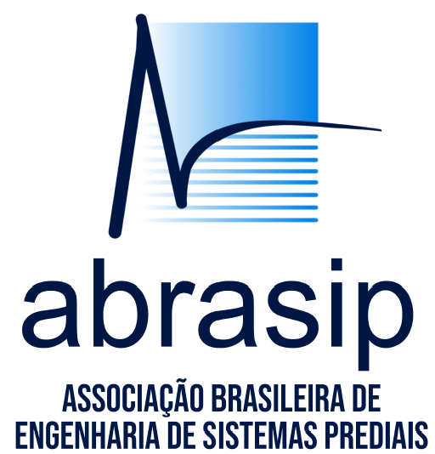
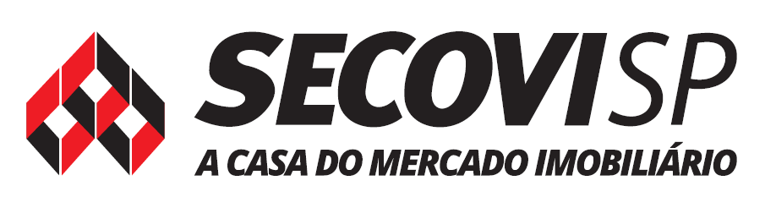
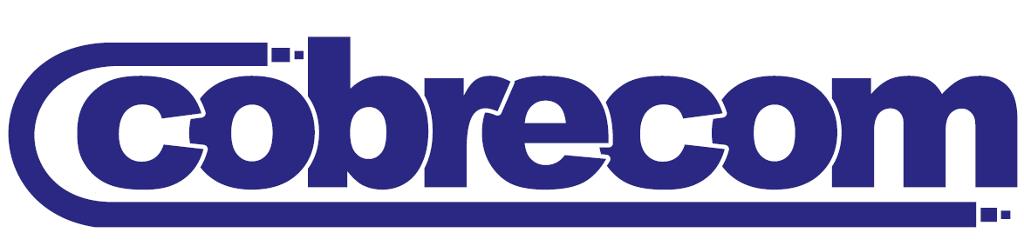

HISTORICAL SUPPORTERS

Slide 24
To face the challenges in the construction of a sustainable infrastructure that provides well-being and security to the end consumer and the Society, observing the precepts of ethics in relationships and complying with the technical and corporate management regulations related to the installation sector.
Potential gains indentified for each category:
Designer– More recognition and participation in the market by engagement in more trustworthy projects.
Installers– More trust from the client in the services that will be provided offered, resulting in increased sales and more participation in the market in function of your sectoral qualification.
Specialized labor – Increase in employability, possibility of a bigger participation in the market in function of you qualification.
WHY BECOME A PARTNER?

Slide 25
Product manufacturers– Increase in product comsumption resulting from the demand for services to the adaptation of installations, market moralization arising from the demand for quality products.
Constructors and Developer –Security in the guarantee offered to the client regarding the installations of his work, offers to the client installations with guarantee
Insurance Companies – Decrease in the compensations paid for accidents in installations and their victims,, reduction in insurance premiums, due to the guarantee of quality installations.
Utility Companies– Guarantee of offering your product with security, guarantee of no rework When connecting your client, decrease of end consumer safety risks, increases in the efficiency of use of services, decrease payment of compensation to the end users, decrease in emergency assistance.
WHY BECOME A PARTNER?

Slide 26
Regulatory Agencies – Standardization in the criteria for products and public agencies services.
Class Associations – Better representation of the interest of the associates.
Bank (financing) – Optimization of the invested capital by the reduction of risks.
City Hall – Safety to the citizen, instruments to the demand of safe installations, decrease in security risks to the community
Conformity Assessment Agencies – New niche of opportunities, more participation in the market due to the demand of society for more reliable and trustworthy projects.
WHY BECOME A PARTNER?

Slide 27




Thank you
Alberto Fossa
Executive director of Abrinstal
diretoria@abrinstal.org.br
Visit us:
www.abrinstal.org.br
Follow us:

